Slide 1
Speech & Audio Processing / Part-II Digital Audio Signal Processing DASP
Marc Moonen
Dept. E.E./ESAT-STADIUS, KU Leuven
marc.moonen@esat.kuleuven.be
homes.esat.kuleuven.be/~moonen/

Slide 2
Outline
Aims/Scope
Contents
Case Study: Hearing Instruments
Lectures/Lab Sessions/Exam
Website/Questions

Slide 3
Aims/Scope
Aim is 2-fold..
Speech & audio per se
S & A industry in Belgium/Europe/…
Topics: Noise Reduction / Acoustic Echo & Feedback Cancellation /
Active Noise Control / Sound Reproduction / ..etc
Develop basic signal processing tools/principles which are also used in many other fields
Spatial filter design (for wireless comms)
Adaptive filter algorithms, filtered-X LMS (for active vibration control)
Kalman filters (for automatic control, navigation, ..)
..etc

Slide 4
Outline
Aims/Scope
Contents
Case Study: Hearing Instruments
Lectures/Lab Sessions/Exam
Website/Questions

Slide 5
Contents
Chapter-1: Introduction
Chapter-2: Single-Channel Noise Reduction
Chapter-3: Microphone Array Processing
– Fixed Beamforming
Chapter-4: Microphone Array Processing
– Adaptive Beamforming
– Multi-Channel Noise Reduction
Chapter-5: Acoustic Echo & Feedback Cancellation
Chapter-6: Sound Field Control
Chapter-7: Sound Field Recording and Reproduction
(= Guest Lecture Dr. Enzo De Sena, Univ.Sussex, UK)
Chapter-8: Hearing Aid Signal Processing
(= Guest Lecture Dr. Jesper Jensen, Oticon/Demant, DK)

Slide 6
Contents: Chapter-2
Single-Channel Noise Reduction
Spectral subtraction methods (spectral filtering)
Iterative methods based on speech modeling
(Wiener & Kalman Filters)
Applications: smartphones, conferencing, hearing aids, …
desired signal s[k]
desired signal
estimate
y[k]
?
desired signal
contribution
noise
contribution
noise signal(s)

Slide 7
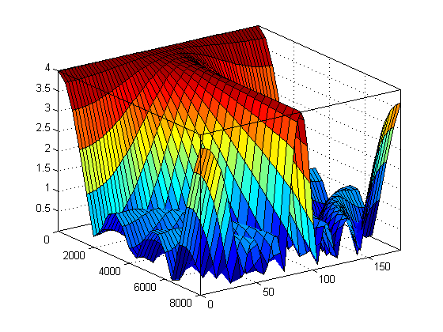
Contents: Chapter-3
Microphone Array Processing
– Fixed Beamforming
Referred to as ‘spatial filtering’ (similar to ‘spectral filtering’)
Applications: smartphones, conferencing, hearing aids, …
Filter-and-sum beamformer

Slide 8
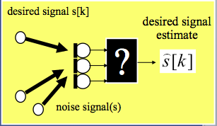
Contents: Chapter-4
Microphone Array Processing
– Adaptive Beamforming
Known (fixed) speaker position
Unknown (time-varying) noise field
– Multi-channel noise reduction
Wiener filtering approach
= spectral+spatial filtering
Applications: smartphones, conferencing, hearing aids, …

Slide 9
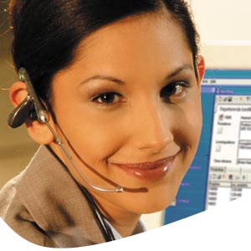
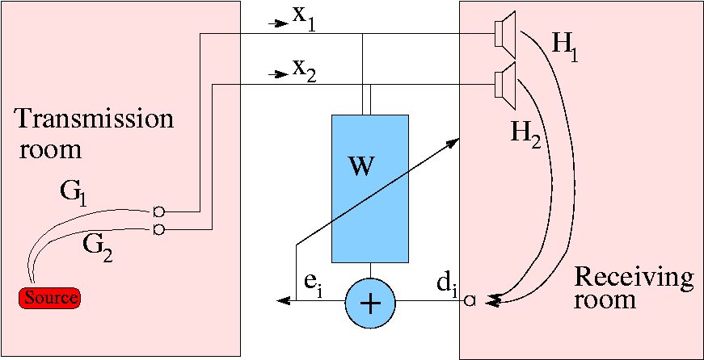
Contents: Chapter-5
Acoustic Echo & Feedback Cancellation
Adaptive filtering problem:
Non-stationary/wideband/… speech signals
Non-stationary/long/… acoustic channels
Adaptive filtering algorithms
AEC Control
AEC Post-processing
Stereo AEC

Slide 10
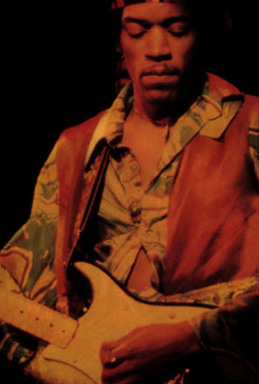
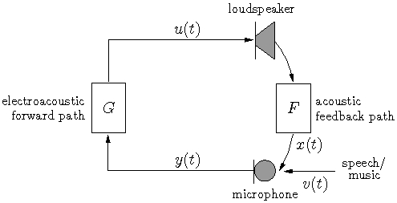
Contents: Chapter-5
Acoustic Echo & Feedback Cancellation
Correlation between filter input (`u’) and near-end signal (‘v’)
Fixes : noise injection, pitch shifting, notch filtering, …
Applications: Hearing aids, public address (PA) systems
Model
F
-

Slide 11
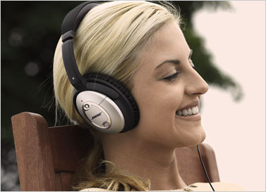
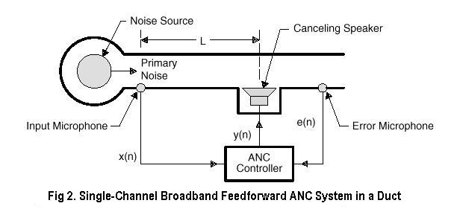
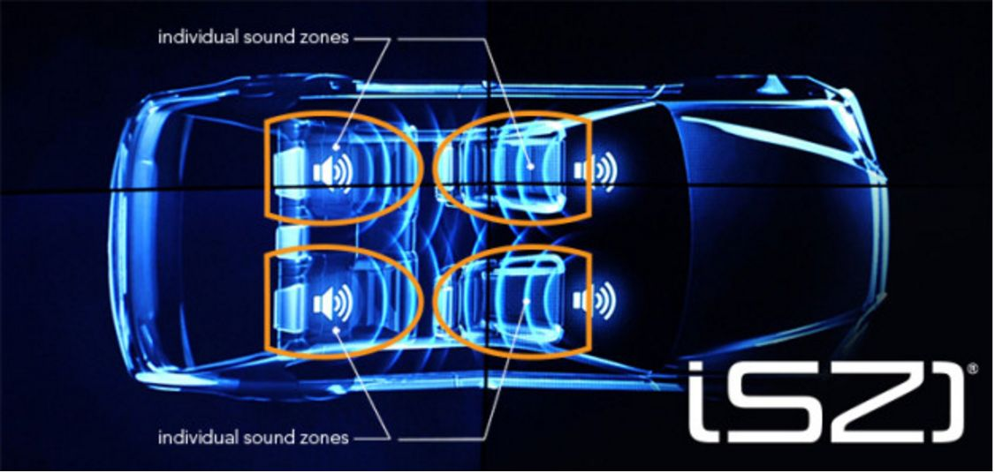
Contents: Chapter-6
Sound Field Control
Active Noise Control
Solutions based on `filtered-X LMS’algorithm
Applications : Active headsets/ear defenders
Sound Zoning
www.harman.com

Slide 12
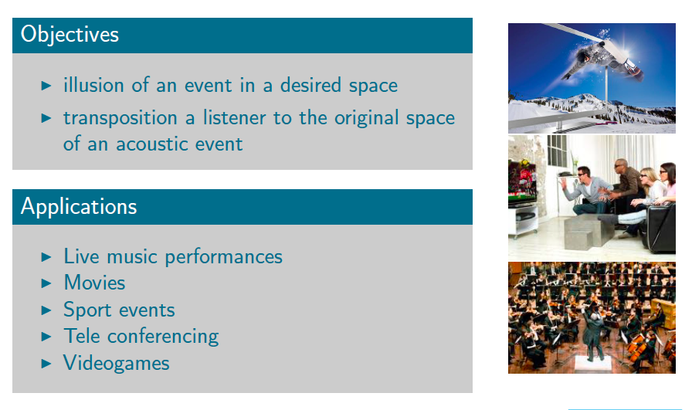
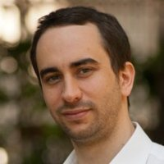
Contents: Chapter-7
Sound Field Recording and Reproduction
Guest Lecture: Dr. Enzo De Sena, University of Surrey, UK
Friday Nov. ??, 10.30-12.30
attendance = mandatory!

Slide 13
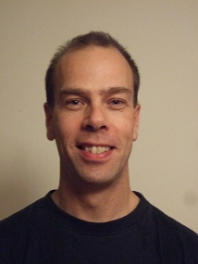
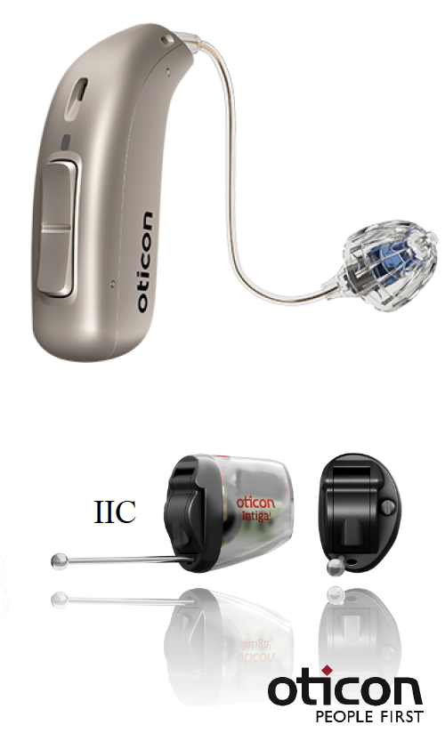
Contents: Chapter-8
Hearing Aid Signal Processing
Guest Lecture: Dr. Jesper Jensen, Oticon/Demant, DK
Friday Nov ??, 10.30-12.30
attendance = mandatory!

Slide 14
Outline
Aims/Scope
Contents
Case Study: Hearing Instruments
Lectures/Lab Sessions/Exam
Website/Questions

Slide 15
Case Study: Hearing Instruments 1/15
DASP Challenges in hearing instruments (next slides)
Dynamic range compression
Noise reduction (=chapter 2-3-4, chapter 7)
Dereverberation
Acoustic feedback cancellation (=chapter 5)
Active noise control (=chapter 6)
Etc.
Technology Challenges in hearing instruments
Small form factor (cfr. user acceptance)
Low power: 1…5mW (cfr. battery lifetime ≈ 1 week)
Low processing delay: 10msec (cfr. synchronization with lip reading)

Slide 16
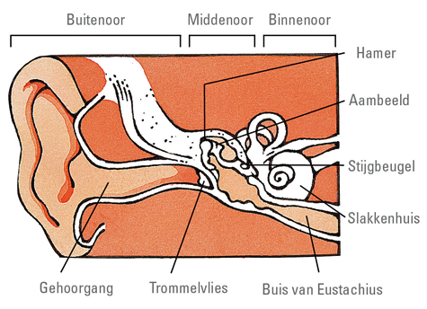
Case Study: Hearing Instruments 2/15
Hearing
Outer ear/middle ear/inner ear
Tonotopy of inner ear: spatial arrangement of where sounds of different frequency are processed
Low-freq tone
© www.cm.be
= Cochlea
Neural activity
for low-freq tone
High-freq tone
Neural activitity
for high-freq tone
Notes:
16

Slide 17
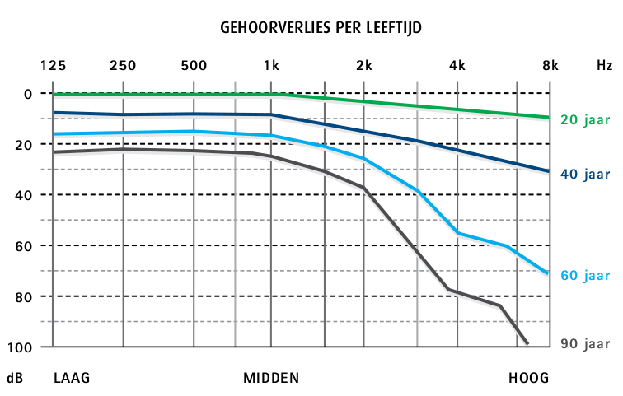
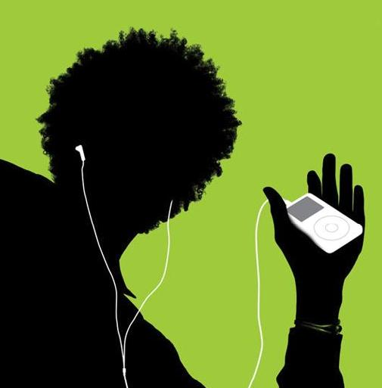
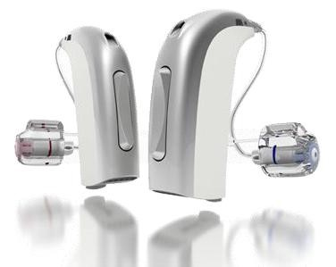
Case Study: Hearing Instruments 3/15
Hearing loss types
Conductive (~outer/middle ear)
Sensorineural (~inner ear)
Mixed
One in six adults (Europe) suffers from hearing loss
…and still increasing
Typical causes
Aging
Exposure to loud sounds
…
Hearing Instruments
Hearing aids: audio output
Bone anchored hearing aids: vibration output
Cochlear implants: electrical stimulation output
…
[Source: Lapperre]

Slide 18
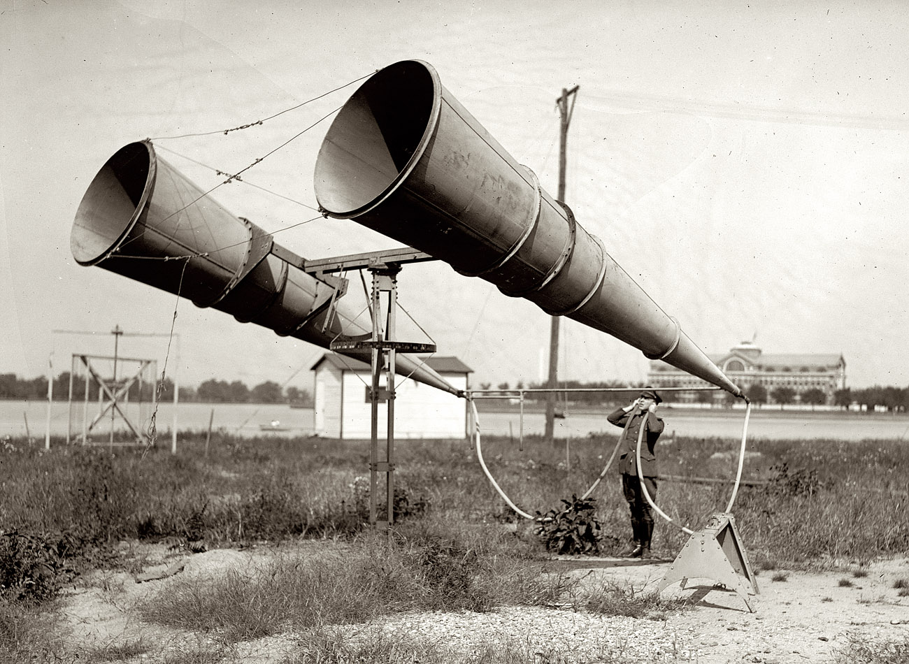
Case Study: Hearing Instruments 4/15
Hearing Aids (HAs)
Audio input/audio output (`microphone-processing-loudspeaker’)
‘Amplifier’, but so much more than an amplifier!!
History:
Horns/trumpets/…
`Desktop’ HAs (1900)
Wearable HAs (1930)
Digital HAs (1980)
State-of-the-art:
MHz’s clock speed
Millions of arithmetic operations/sec, …
Multiple microphones
1921
2007 (Oticon)

Slide 19
Case Study: Hearing Instruments 5/15
DASP Challenges: Dynamic range compression
Dynamic range & audibility
Normal hearing Hearing impaired
subjects subjects
(frequency dependent)
Level
100dB
0dB

Slide 20
Case Study: Hearing Instruments 5/15
DASP Challenges: Dynamic range compression
Dynamic range & audibility
Hence need (frequency &) signal amplitude dependent amplification
Level
100dB
100dB
Output Level (dB)
0dB
0dB
100dB
0dB
Input Level (dB)

Slide 21
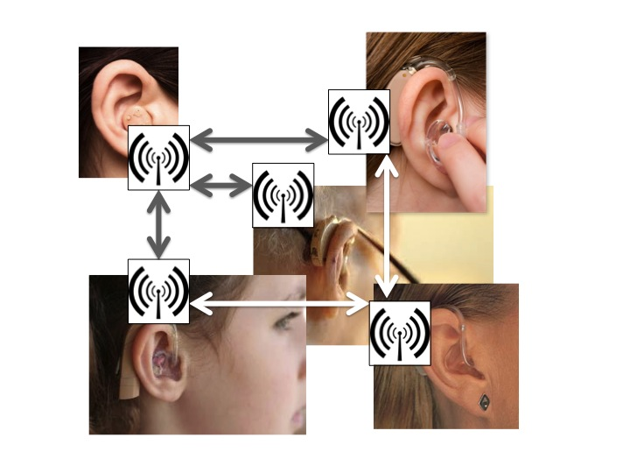
Case Study: Hearing Instruments 6/15
However: Audibility does not imply intelligibility
Hearing impaired subjects
need 5..10dB larger
signal-to-noise ratio (SNR)
for speech understanding in
noisy environments
Need for noise reduction
(=speech enhancement) algorithms:
State-of-the-art: monaural 2-microphone adaptive noise reduction (p22)
Near future: external microphone nodes & binaural noise reduction
(with wireless links) (p23-23)
Not-so-near future: cooperative HAs (p25)
SNR
20dB
0dB
30 50 70 90
Hearing loss (dB, 3-freq-average)

Slide 22
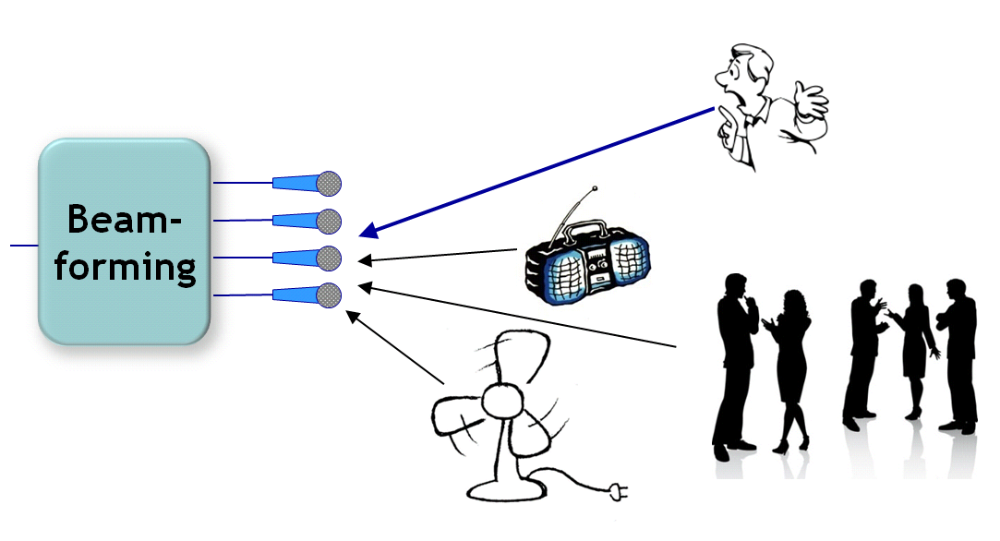
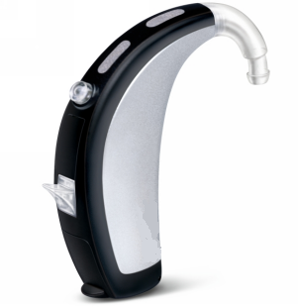
Case Study: Hearing Instruments 7/15
DASP Challenges: Noise reduction & beamforming
Multimicrophone ‘beamforming’, typically with 2 microphones
e.g. ‘directional’ front microphone and ‘omnidirectional’ back microphone
PS: related/specific challenge = wind noise
“filter-and-sum” the
microphone signals
Chapter 3-4

Slide 23
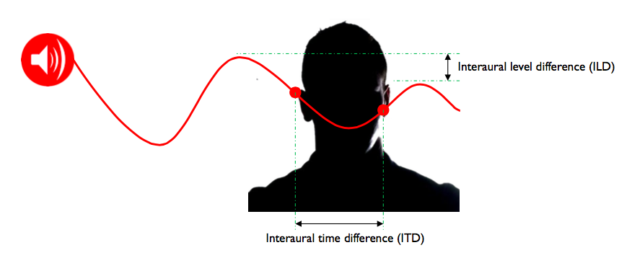
Case Study: Hearing Instruments 8/15
Binaural hearing based on binaural auditory cues
ITD (interaural time difference)
ILD (interaural level difference)
Binaural cues (ITD: f < 1500Hz, ILD: f > 2000Hz) used for
Sound localization
Noise reduction
=`Binaural unmasking’ (‘cocktail party’ effect) : 0-5dB

Slide 24
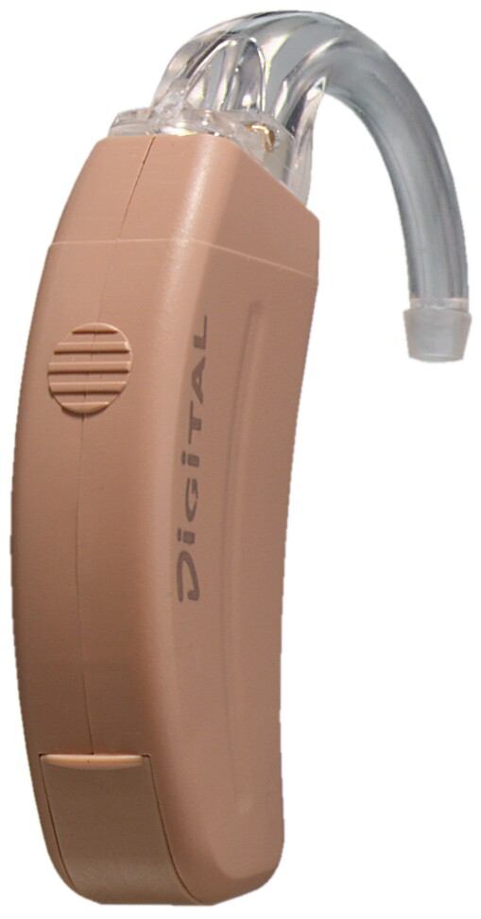
Case Study: Hearing Instruments 9/15
Binaural hearing aids
Two hearing aids (L&R) with wireless link & cooperation
Opportunities:
More signals (e.g. 2*2 microphones)
Better sensor spacing (17cm i.o. 1cm)
Constraints: power/bandwith/delay of wireless link
..10kBit/s: coordinate program settings, parameters,…
..300kBits/s: exchange 1 or more (compressed) audio signals
Challenges:
Improved localization through (speech) cue preservation
Improved noise reduction through (speech+noise) cue preservation (=benefit from binaural unmasking)
Signal selection/filtering, audio coding, synchronisation, …
Chapter 7

Slide 25
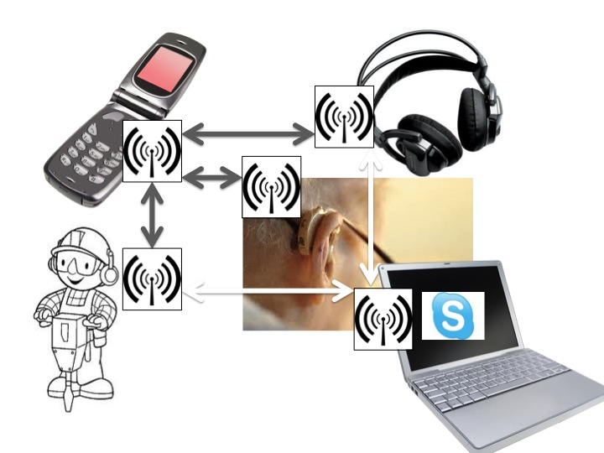
Case Study: Hearing Instruments 10/15
Future: Multi-node noise reduction
in sensor networks/Internet-of-Things
Chapter 7

Slide 26
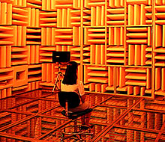
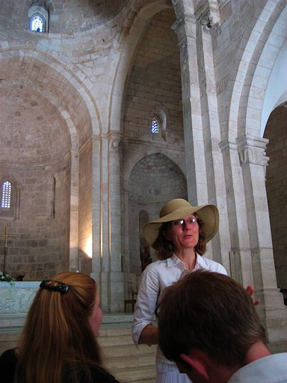
Case Study: Hearing Instruments 11/15
DASP Challenges: Dereverberation
Reverb = filtering effect (‘echo-ing’) of acoustic channel in between speaker and microphone(s)
Reverb has an impact on speech understanding
Dereverberation = undo filtering by acoustic channel (e.g. ‘inverse filtering’)

Slide 27
Case Study: Hearing Instruments 12/15
DASP Challenges: Acoustic feedback cancellation
Problem statement: Loudspeaker signal is fed back into microphone, then amplified and played back again
Closed loop system may become unstable (=howling)
Similar to feedback problem in public address systems (for the musicians amongst you)
Similar to echo cancellation in GSM handsets, Skype,…
but more difficult due to signal correlation
Model
F
-
Chapter 5

Slide 28
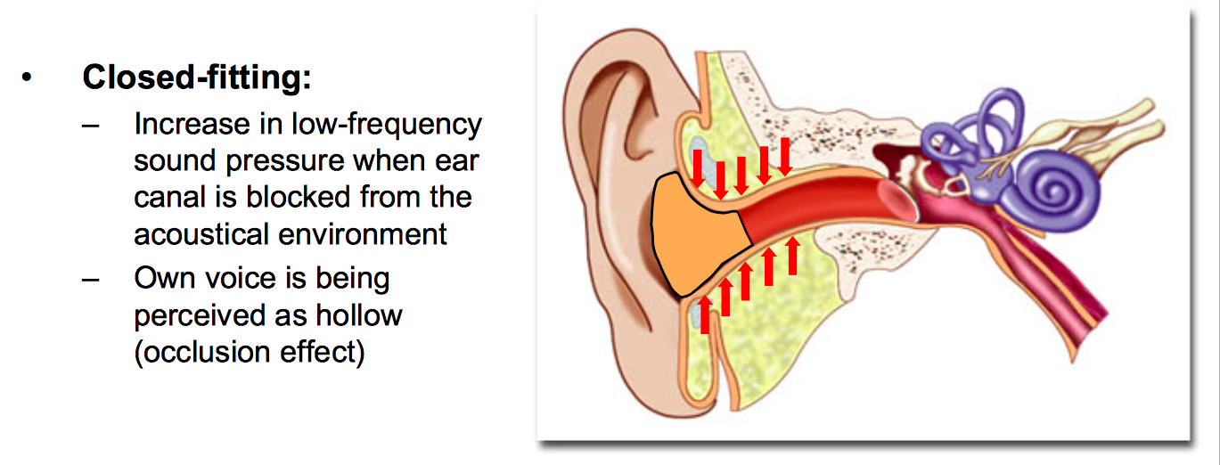
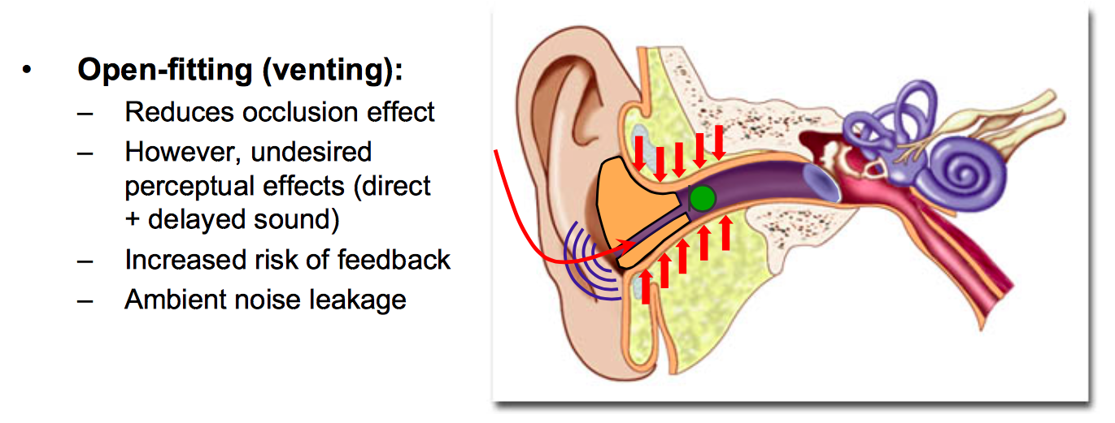
Case Study: Hearing Instruments 13/15
DASP Challenges: Active noise control (ANC)
ANC to counteract noise leakage & occlusion effect,
exploiting additional ‘internal’ reference microphone
© S.Doclo/Univ.Oldenburg
Chapter 6

Slide 29
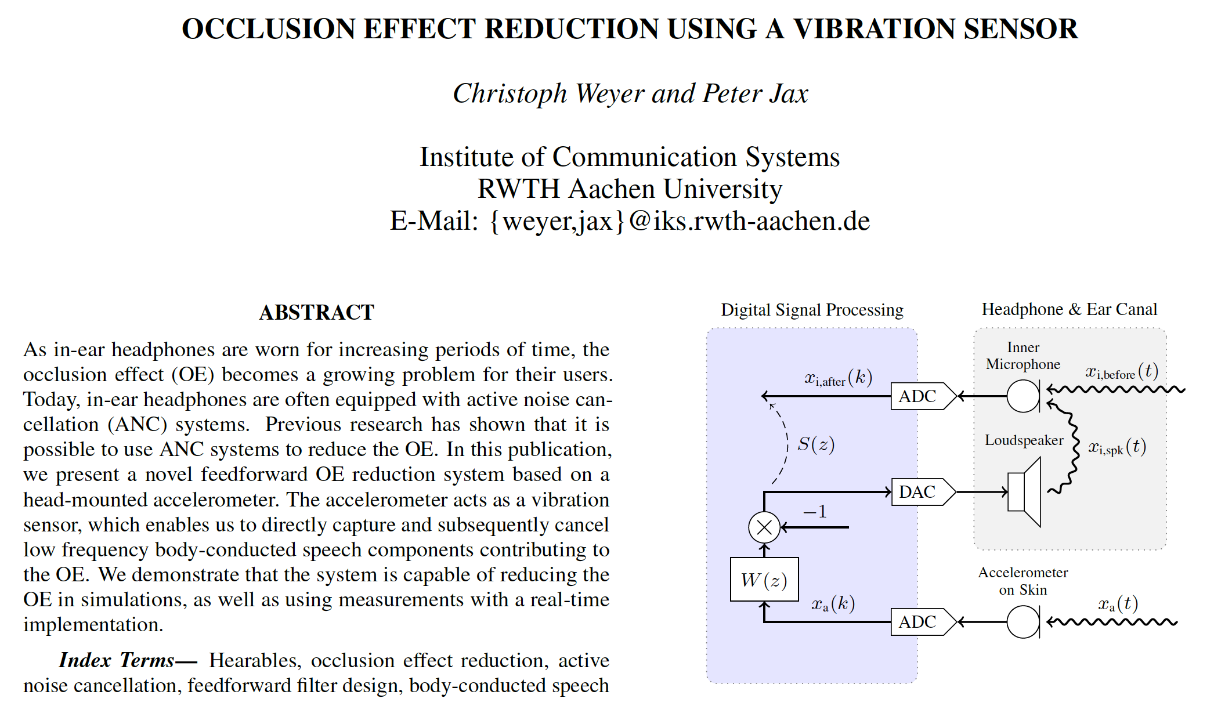
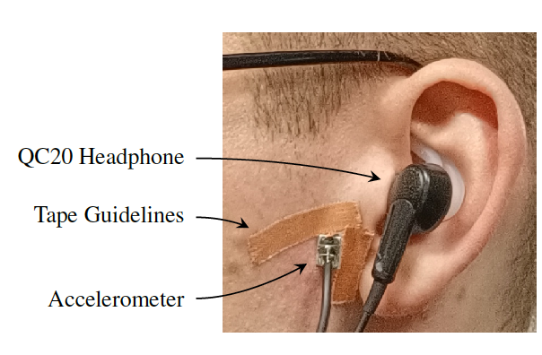
Case Study: Hearing Instruments 14/15
DASP Challenges: Occlusion Effect Reduction
Chapter 6

Slide 30
Case Study: Hearing Instruments 15/15
DASP Challenges: …piecing things together
Future: GPS for localization, head-trackers, eye-trackers, EEG-sensors for auditory attention detection, etc.
Auditory scene analysis
for optimal parametrization
and control of DSP algorithms
(e.g. machine learning based classification:
quiet/speech in noise/speech in loud
noise/speech in car/music/…)

Slide 31
Outline
Aims/Scope
Contents
Case Study: Hearing Instruments
Lectures/Lab Sessions/Exam
Website/Questions

Slide 32
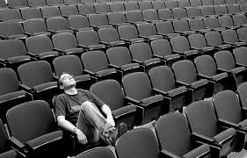
Lectures
Lectures: 8 Lectures
Course Material: Slides
Use version 2023-2024 !
Download (pdf/ppt) from TOLEDO or DASP webpage
homes.esat.kuleuven.be/~dspuser/dasp/
Master copy can be made available if needed
Optional: Slides 2020-2021 with audio
Course Prerequisite: DSP-CIS H05F3A/H05F1A
filter design, filter banks, optimal & adaptive filters
https://homes.esat.kuleuven.be/~dspuser/DSP-CIS/2022-2023/

Slide 33
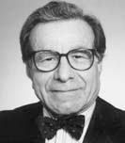
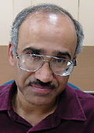
Literature
Literature (General DSP)
Simon Haykin
`Adaptive Filter Theory’ (Prentice Hall 1996)
P.P. Vaidyanathan
`Multirate Systems and Filter Banks’ (Prentice Hall 1993)
Literature (Speech/Audio/Acoustics)
S.L. Gay & J. Benesty
`Acoustic Signal Processing for Telecommunication’ (Kluwer 2000)
M. Kahrs & K. Brandenburg (Eds)
`Applications of Digital Signal Processing to Audio and Acoustics’
(Kluwer1998)
B. Gold & N. Morgan
`Speech and Audio Signal Processing’ (Wiley 2000)

Slide 34
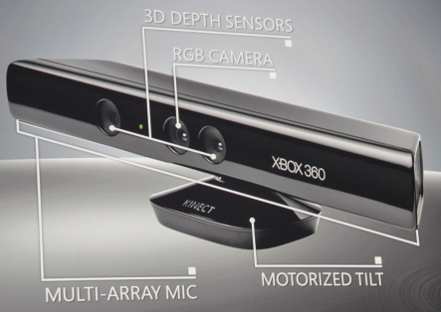
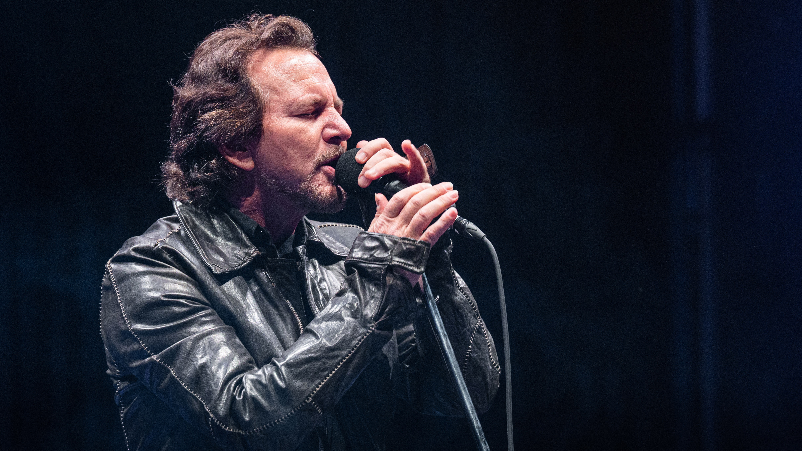
Lab Sessions/Project
Acoustic sound field synthesis/Binaural audio
Pre-filter design
Frequency domain realization (OLA/WOLA)
Noise reduction
Active noise control …all in a simulated set-up
Virtual sound source
Loudspeaker array to produce sound field such that virtual sound source is perceived as coming from virtual sound source location

Slide 35
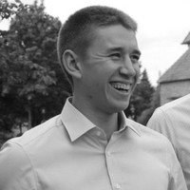
Lab Sessions/Project
Runs over 4 weeks (non-consecutive)
Each week
1 PC/Matlab session (supervised, 2.5hrs)
2 ‘Homework’ sesions (unsupervised, 2*2.5hrs)
‘Deliverables’ after week 2 & 4
Grading: based on deliverables, evaluated during sessions
TAs: jesper.brunnstroem@kuleuven.be (English+Swedish)
julian.schott@kuleuven.be (English+German+Dutch)
PS: groups of 2
..be there !

Slide 36
Time Budget
 | Lecture (hrs) | Self Study (hrs)
Chapter-1 | 2 | 2 (⍯ exam material)
Chapter-2 | 2 | 6
Chapter-3 | 2 | 6
Chapter-4 | 2 | 6
Chapter-5 | 2 | 6
Chapter-6 | 2 | 6
Chapter-7 (guest lecture) | 2 (attendance=mandatory) | 6
Chapter-8 (guest lecture) | 2 (attendance=mandatory) | 6
TOTAL = 60 hrs
 | Lab Session (hrs) | Homework (hrs)
Session-1 | 2.5 | 5
Session-2 | 2.5 | 5
Session-3 | 2.5 | 5
Session-4 | 2.5 | 5
TOTAL = 30 hrs

Slide 37
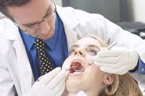
Exam
Oral Written exam
Open book (only printed material, no electronic devices !!)
Grading:
6*2.5 for questions 1-to-6
+ 5 for project
___
= 20
Exam feedback: send request to marc.moonen@kuleuven.be

Slide 38
Retake Exam
Oral Written exam
Open book (only printed material, no electronic devices !!)
Grading
6*2.5 for questions 1-to-6
+ 5 for for question-7 (related to project work)
___
= 20
Exam feedback: send request to marc.moonen@kuleuven.be

Slide 39
Website
Course info & material in…
TOLEDO
http://homes.esat.kuleuven.be/~dspuser/dasp/
Slides
Schedule
Contact: julian.schott@kuleuven.be

Slide 40
Questions?
Toledo
Ask Teaching Assistants (during lab sessions)
E-mail questions to
TA’s
or marc.moonen@esat.kuleuven.be
3) Make appointment
marc.moonen@esat.kuleuven.be
ESAT Room B00.14

